Slide 1

Cascading ALTO
IETF-116
Ingmar Poese
27/03/2023

Slide 2

2013
Founded as a Spin-off of Deutsche Telekom
About BENOCS
Location: Berlin, Germany
Industry: Telecommunications, Network Telemetry
Mission: To improve network traffic conditions and visibility
2015
First live customers for BENOCS Director
2018
Fully developed BENOCS Analytics enters the market
2020
Customer base expanded globally
Notes:
<number>

Slide 3
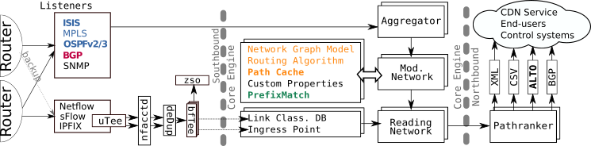
CE (Core Engine) Architecture
General Architecture Gather Information
Primarily from control plane
IGP (IS-IS, OPSFv2/3)
BGP (RR-connection to all border routers)
Augment Information (SNMP, (streaming) telemetry, Inventory, propriatory...)
Convert deployment specific information/configuration into an internal, standardized format
Prefixmatch → match a prefix to originate from a specific router
Pathcache → use IGP to calculate path throught the network
Building an ALTO map based on this information depends on the ingress point
FROM:
Steering Hyper-Giants’ Traffic at Scale, Pujol et. al., CoNext’19

Slide 4
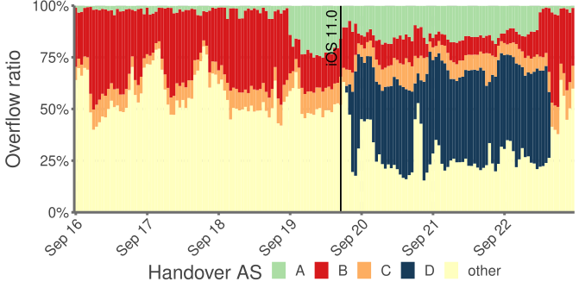
Challenge 1: Ingress Point
Definition Determine where traffic from an IP/subnet enters the network
Easy
Traffic enters via caches/PNI. No path asymmetrical path, no middle party(s), bi-lateral relationship
This is the majority of the traffic
Hard
Traffic enters via Peering.
IGP/BGP cannot be used
Inference statistically via Dataplane
Compute/Data heavy operation
Needs to always be up to date
“Small” amount of overflow can have severe impact
Dissecting Apple’s Meta-CDN during an ios Update, Blending et al., IMC’18

Slide 5
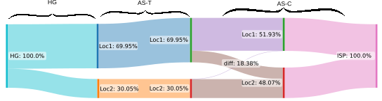
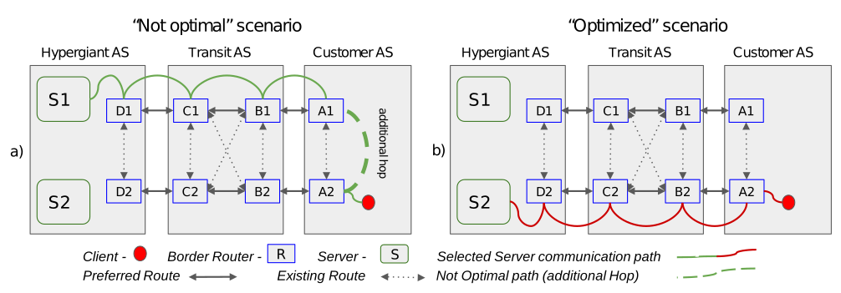
Challenge 2: Cascasing Path optimization
Multi Tier ASN Setup
Larger networks run mutiple ASNs.
Can be private or offical ASNs
One company or conglomerate of companies
HG/CDN caches are usually deployed in the parent ASN
Ingress Point issues resurface
Unpublished: currently under submission
Unpublished: currently under submission

Slide 6
Solution: Multi-domain ALTO
Multi-Domain ALTO to the rescue
Partial path information from different ASNs along the AS path builds a full overview
AS-State map made up if link-state protocol networks ?
Individual, inaccurate(?), data-heavy operations can be ceased
ALTO now supplies the information
ALTO can solve this issue by supplying Maps for each individual network
One (replicated) Meta-ALTO collects the maps and builds a full overview (DNS like ?)
Each local ALTO pulls information from all other ALTO individually.

